Slide 1
Craft Beers and Breweries in the U.S.
Sid Swarupananda
Sean mcWhirter

Slide 2
MSDS 6306: Doing Data Science - Case Study 01 Description
Our core datasets includes information from a sample set of 2,410 US craft beers produced by 558 breweries, with specific information such as:
Beers.csv:
Name: Name of the beer (example: Snapperhead IPA)
Beer_ID: Unique identifier of the beer
ABV: Alcohol by volume of the beer
IBU: International Bitterness Units of the beer
Brewery_ID: Brewery id associated with the beer
Style: Style of the beer (example: American Pale Ale )
Ounces: Serving size of the beer
Breweries.csv:
Brew_ID: Unique identifier of the brewery.
Name: Name of the brewery.
City: City where the brewery is located.
State: U.S. State where the brewery is located.

Slide 3
MSDS 6306: Doing Data Science - Case Study 01 Analysis
We examined below topics as part of our analysis:
Breweries per state
Median alcohol content (ABV) per state
Median international bitterness (IBU) per state
Beers with highest Alcohol by Volume (ABV) and International Bitterness Unit (IBU)
Summary stats of Alcohol by Volume(ABV)
Analysis of relationship between Alcohol by Volume (ABV) and International Bitterness Unit (IBU)
Investigate the difference with respect to ABV and IBU between IPAs and other types of Ale

Slide 4
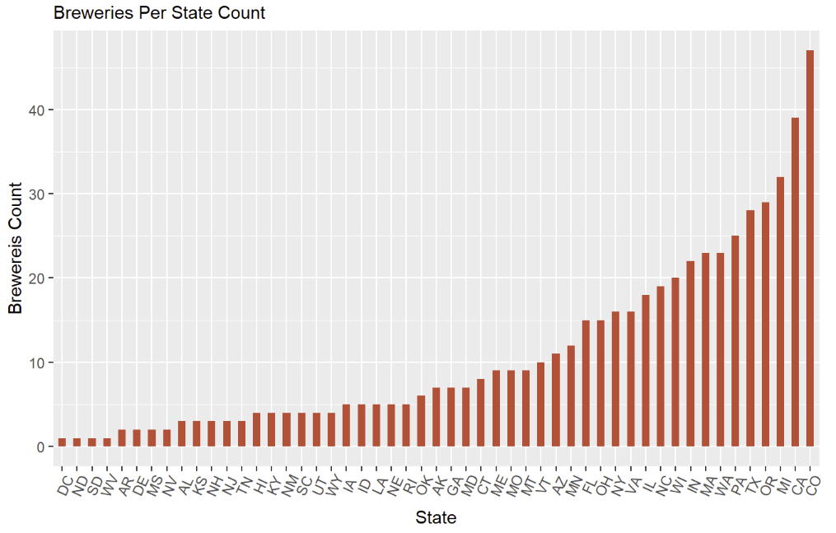
How many breweries are present in each state?
Range of breweries 1 – 47
Average number of breweries per state – 10.9
Colorado leads with 47 Breweries.
Looking further into this by comparing to population may lead to insights

Slide 5
Address the missing values in each column
Column | Missing Values
ABV | 62
IBU | 1005
ABV and IBU are the only columns with missing values.
However, since we have a high number of observations, we should be able to omit the missing values and still be able to determine any significant insights.

Slide 6
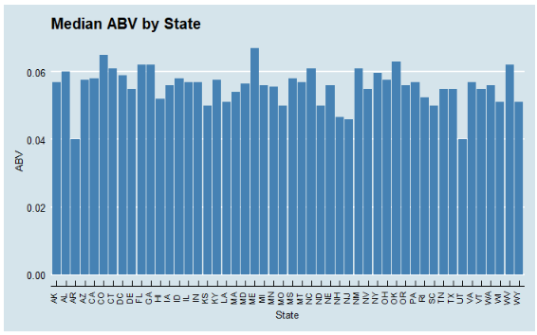
Compute the median alcohol content and international bitterness unit for each state. Plot a bar chart to compare
Median Alcohol content (ABV) is fairly consistent around 6%

Slide 7
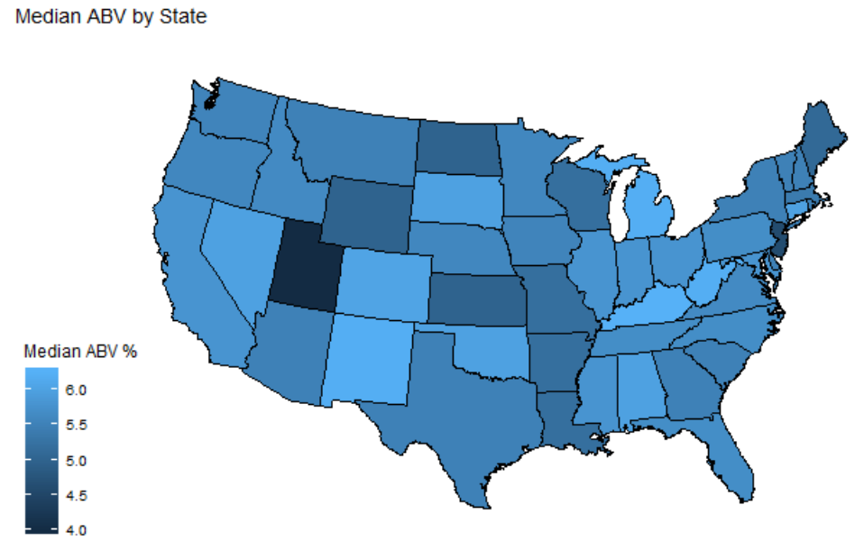
Median ABV by State
Colorado also has the most breweries
OK and NM have fewer breweries

Slide 8
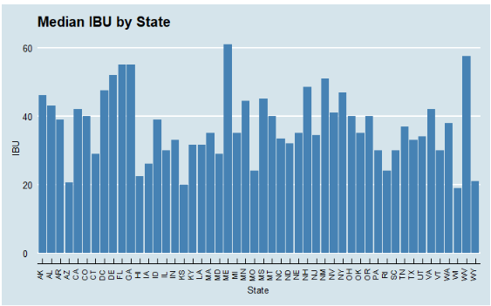
Median IBU by State
Certain states (ME and WV) seem to stand out above the rest
Median international bitterness (IBU) per state is very much varied

Slide 9
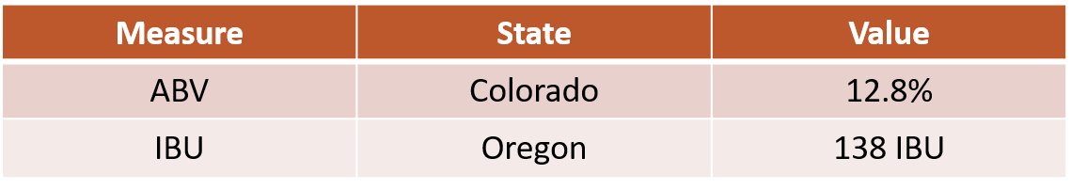
Which state has the maximum alcoholic (ABV) beer? Which state has the most bitter (IBU) beer?

Slide 10

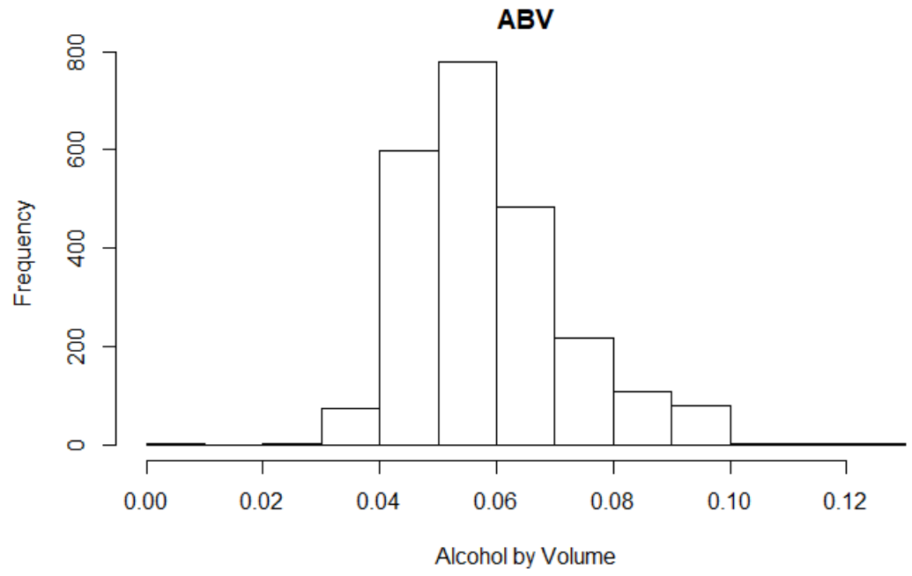
Comment on the summary statistics and distribution of the ABV variable
Some beers don’t even measure 1%. Median was 5.7%, Mean or average was 5.9% and the maximum ABV was around 13%.
Looking at a histogram of the data, it appears to be a bit right-skewed. This makes sense because beer is not meant to be a very high ABV drink-the high ABV beers would be more rare.

Slide 11
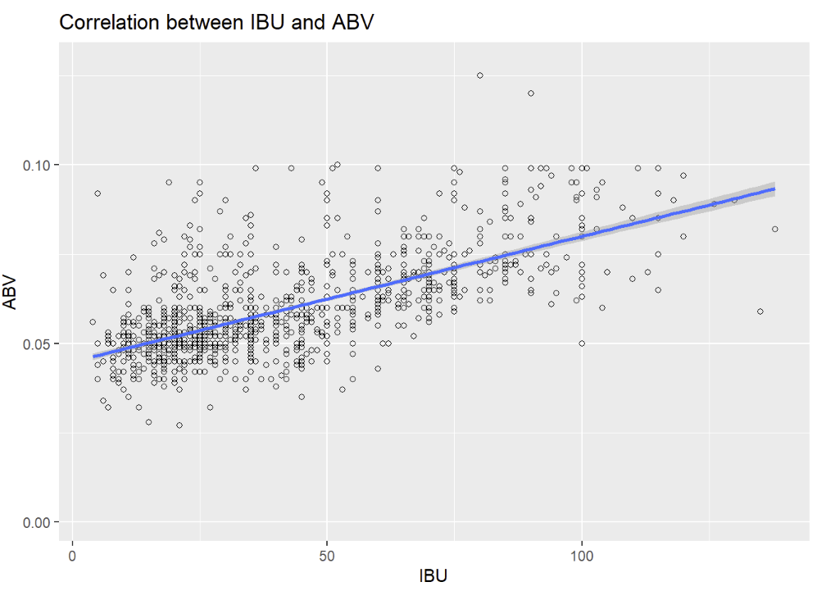
Is there an apparent relationship between the bitterness of the beer and its alcoholic content? Draw a scatter plot.
Visual evidence of a positive linear relationship
Further investigation is needed to determine the significance of the relationship

Slide 12
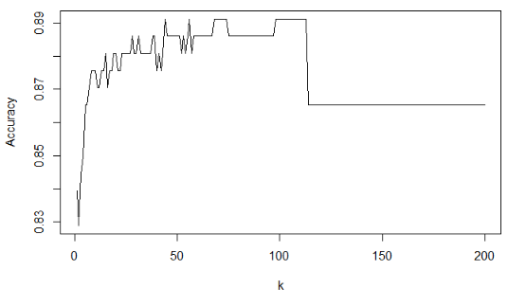
The difference with respect to IBU and ABV between IPAs (India Pale Ales) and other types of Ale (any beer with “Ale” in its name other than IPA).
Model called K-NN (Nearest Neighbor)
Approximately 105 should give us best accuracy
Accuracy of 88.6%

Slide 13
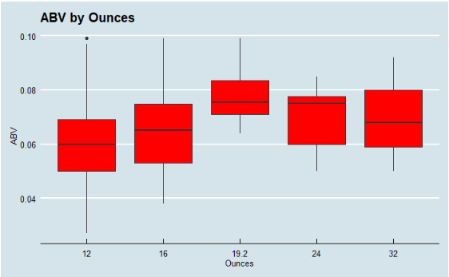
Other Insights – ABV by Ounces?

Slide 14
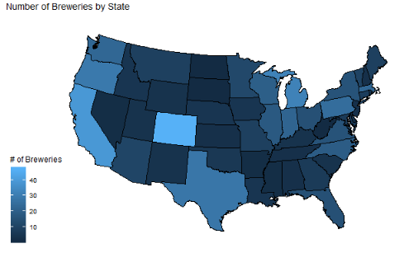
Other Insights – Where to go next?
Acquisition top strategy (per Anheuser-Busch 2018 Report)
Colorado for diversity of craft breweries
Potential product lines at low-moderate cost
Gain back market share

Slide 15
Conclusion
States with highest breweries – Colorado, California and Michigan
States with highest ABV and IBU are Colorado and Oregon
Medial alcohol content per state is fairly consistent around 6% and median international bitterness per state is very much varied.
There is evidence to suggest that a positive linear relationship exists between IBU and ABV
K-NN model to identify beer type based on ABV and IBU values – accuracy of 88.6%
ABV vs ounces of serving
Map with potential areas for acquisition search
Github repo that contains all information about this analysis is available here. It contains all relevant information such as raw data files, Rmd scripts, R html output, etc.,

